Slide 1
SATHI VIJAY KUMAR REDDY
Final Project

Slide 2
KEY LOGGER AND SECURITY
Keyloggers are malicious software designed to record keystrokes, capturing sensitive information such as passwords and personal data. They pose significant security risks by potentially transmitting this information to unauthorized parties. Effective protection includes using updated antivirus software, enabling two-factor authentication, and being cautious about downloading and installing software from untrusted sources.
Hardware Keyloggers: These are physical devices that are plugged into the keyboard or installed within the computer's hardware. They capture keystrokes directly from the keyboard.
Software Keyloggers: These are programs that run silently in the background, recording keystrokes and sending the captured data to an attacker. They can be installed through malicious downloads, phishing emails, or exploit vulnerabilities in software.

Slide 3


AGENDA
Advantages Of Keylogger
Disadvantages Of Keylogger
Security Measures Against Keyloggers
Problem Statement
Project Overview
Who Are The End Users?
Your Solution And Its Value Proposition
The Wow In Your Solution
Modelling
Result
3/21/2024 Annual Review

Slide 4

ADVANTAGES OF KEYLOGGER
Monitoring and Surveillance: Keyloggers can be used for legitimate monitoring purposes, such as parental control to ensure children's online safety or employee monitoring to track productivity and adherence to company policies.
Data Recovery: In situations where data is accidentally lost, keyloggers can sometimes help recover the lost information by capturing keystrokes before they are deleted.
Investigative Tool: Law enforcement agencies and legal professionals can use keyloggers as part of their investigative toolkit to gather evidence in criminal cases or track suspicious activities.
System Diagnostics: Keyloggers can assist IT professionals in diagnosing technical issues and troubleshooting problems by providing a detailed log of user interactions.

Slide 5

DISADVANTAGES OF KEYLOGGER
Privacy Invasion: Keyloggers have the potential to infringe on individuals' privacy by capturing sensitive information, such as passwords, personal messages, and browsing history, without their consent or knowledge.
Misuse and Abuse: Keyloggers can be misused for malicious purposes, such as stealing passwords, financial information, or intellectual property, leading to identity theft, financial fraud, or corporate espionage.
Legal and Ethical Concerns: The use of keyloggers without proper authorization or consent may violate privacy laws and ethical principles, resulting in legal repercussions and damage to reputation if discovered.
Security Vulnerabilities: Keyloggers themselves can become targets for exploitation by cybercriminals, leading to security vulnerabilities and potential breaches if not properly secured or maintained.
Cost and Complexity: Implementing comprehensive security measures can be costly and complex, requiring investment in software, hardware, personnel training, and ongoing maintenance.

Slide 6

SECURITY MEASURES AGAINST KEYLOGGERS
Use Antivirus Software: Install reputable antivirus software that includes anti-keylogger features. Regularly update it to detect and remove keyloggers and other malware.
Enable Firewall: Keep your firewall activated to block unauthorized access to your computer and network, which can help prevent keyloggers from transmitting data.
Use Virtual Keyboards: When entering sensitive information like passwords, use virtual keyboards provided by operating systems or security software. Virtual keyboards can help evade hardware-based keyloggers.
Update Operating System and Software: Keep your operating system, browsers, and all applications up to date with the latest security patches and updates. This helps to close vulnerabilities exploited by keyloggers.

Slide 7
PROBLEM STATEMENT
The increasing prevalence of keyloggers poses a significant threat to digital security by covertly recording keystrokes and capturing sensitive information such as passwords, credit card numbers, and personal identification details. These malicious programs can lead to unauthorized access to personal and financial accounts, resulting in identity theft, financial loss, and privacy breaches.
The challenge is to develop robust and proactive security measures that can detect, prevent, and mitigate the impact of keyloggers, ensuring the protection of users' data and maintaining the integrity of digital systems. This involves a combination of advanced detection algorithms, user education, and secure software practices to create a comprehensive defense against keylogging attacks.

Slide 8
PROJECT OVERVIEW
Objective:
Develop a comprehensive system to detect and prevent keyloggers.
Scope:
Create software tools for detecting and removing keyloggers.
Develop guidelines for best practices in cyber security to prevent keylogger installation.
Educate end users on recognizing and responding to keylogger threats.
Approach:
Combination of real-time detection algorithms ,user education , and system hardening.

Slide 9
WHO ARE THE END USERS?
Cybercriminals: The primary end users, using keyloggers to steal sensitive information such as login credentials, credit card numbers, and personal data for financial gain or identity theft.
Industrial Spies: Individuals or entities using keyloggers to gather confidential business information, trade secrets, and competitive intelligence from rival companies.
Disgruntled Employees: Employees who may use keyloggers to collect sensitive information from their employers for sabotage, theft, or personal revenge.
Governments and Intelligence Agencies: Entities using keyloggers for surveillance and intelligence gathering on individuals or groups of interest, both domestically and internationally.
Private Investigators: Individuals who might use keyloggers in investigations to monitor and gather evidence on suspects, often in cases of fraud, infidelity, or other personal matters.

Slide 10

YOUR SOLUTION AND ITS VALUE PROPOSITION
Real-time Keylogger Detection: Advanced algorithms to detect keylogger behaviour in real time.
Keylogger Removal Tools: Software to safely remove detected keyloggers from systems.
User Education and Training: Resources and training programs to inform users about keylogger threats and prevention techniques .
System Hardening Practices: Guidelines for securing systems against keylogger installation.
Value Proposition:
Comprehensive Protection: Multi-layered security approach covering detection, removal, and prevention.
Ease of Use: User-friendly tools and resources accessible to non-technical users.
Proactive Security: Focus on both reactive measures (detection and removal) and proactive measures (prevention and education).

Slide 11
THE WOW IN YOUR SOLUTION
1. User-Friendly Interface with Detailed Analytics:
WOW: A sleek, intuitive dashboard that not only alerts users to threats but also educates them on potential vulnerabilities and how to avoid them.
Value: Empowers users with knowledge and control, making security accessible and comprehensible even for non-technical individuals.
2. Multi-Layered Encryption Protocols:
WOW: Implement advanced encryption techniques like homomorphic encryption and attribute-based encryption to protect sensitive data even if intercepted by keyloggers.
Value: Ensures data remains secure under multiple scenarios, significantly reducing the risk of data breaches.
3. Cross-Platform Compatibility:
WOW: Ensure the solution is compatible across various operating systems and devices, providing seamless protection in diverse IT environments.
Value: Offers flexible and consistent security, catering to a wide range of users and organizational setups.
11

Slide 12
MODELLING
Import Required Modules:
Use Python's keyboard module to capture keystrokes.
Optionally, use other modules for logging, encryption, or network communication.
Set Up Logging:
Configure logging settings to specify the format and destination of log files.
Define Keylogger Function:
Create a function to capture and log keystrokes.
Use the keyboard.on_press() method to register a callback function to capture each key press event.
Main Function:
Create a main function to start the keylogger and keep it running indefinitely.
Testing and Deployment:
Test the keylogger program to ensure it captures keystrokes correctly.
Deploy the keylogger on target systems if necessary, ensuring compliance with legal and ethical considerations.
12

Slide 13

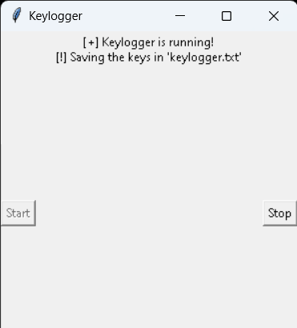
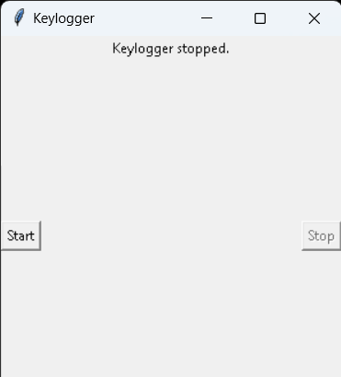
RESULT
The result of a keylogger program typically involves capturing and logging keystrokes entered by a user on a keyboard. These logged keystrokes can then be used for various purposes, depending on the intent of the keylogger user. The covert nature of keyloggers allows them to capture sensitive information, including passwords, personal messages, and financial details, without the user's knowledge or consent. This poses serious risks to individuals, organizations, and society at large, including identity theft, financial fraud, and unauthorized access to confidential data.
13

Slide 14
PROJECT LINK
https://github.com/SATHIVIJAYKUMARREDDY/sathivijaykumarreddy_project.git

